Slide 1
Team 5 Conceptual Design
Dillon Williams
Nidhay Patel
Ryan Reed
Michel Turpeau
Austin Sigg

Slide 2
Design Update
More like Barrel shape
Motor at Bottom
Each level will have lock
LEDs to guide

Slide 3
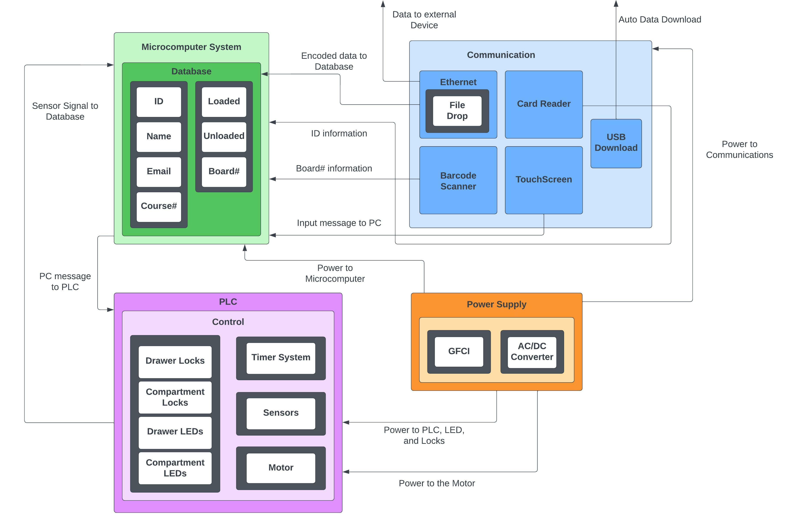

Slide 4
Constraints
Engineering Standards
|||||||||
Ethical Considerations
|
|
|
|
|
|
|
|
|
Broader Impacts
National Electric Safety Code
High Voltage Components
Multiple Sensors and Wires
Power system must have GFCI (NEC 422.51)
Prevent from Stealing Devices
Safety of Students when checking out device
Not to take away jobs of Office Associates
Job simplified
Less paperwork

Slide 5
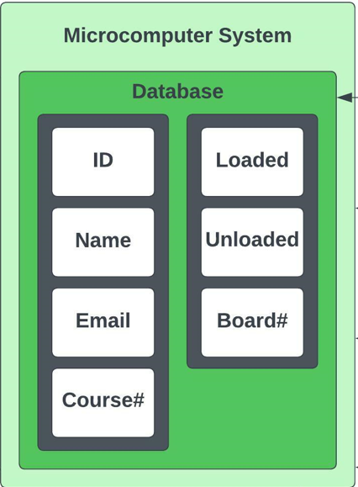

Microcomputer system
To hold Database
Must have Connectivity Ports
Also responsible for sending & receiving information/signal
UI
LCD Touchscreen to collect student information
Select Board to Vend

Slide 6
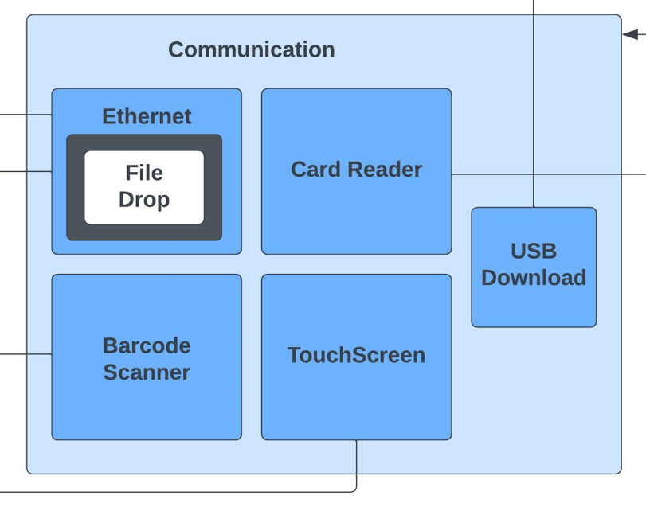
PC connections
miniPC
SQL Database
Touchscreen
Eagle Card Reader
Ethernet
USB

Slide 7
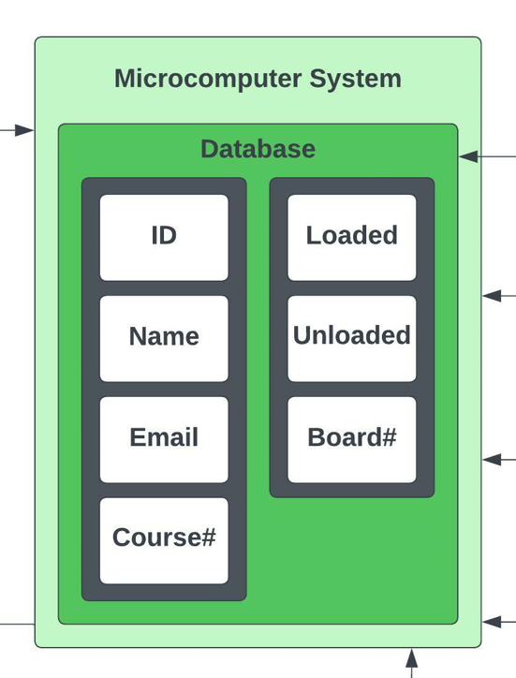
SQL Database
Inventory
Loaded
Unloaded
Student Information
T#
Name
Email
Course & Board#
Ethernet
CSV File

Slide 8
Constraints
USB
Database
Card Scanner
Be able to automatically transfer data to the faculty’s thumb drive when inserted into the machine
Have a created Schema available and have a server to contain the student data and Schema itself
Be able to read data from Eagle Cards and store the identifier in the database for faculty use

Slide 9
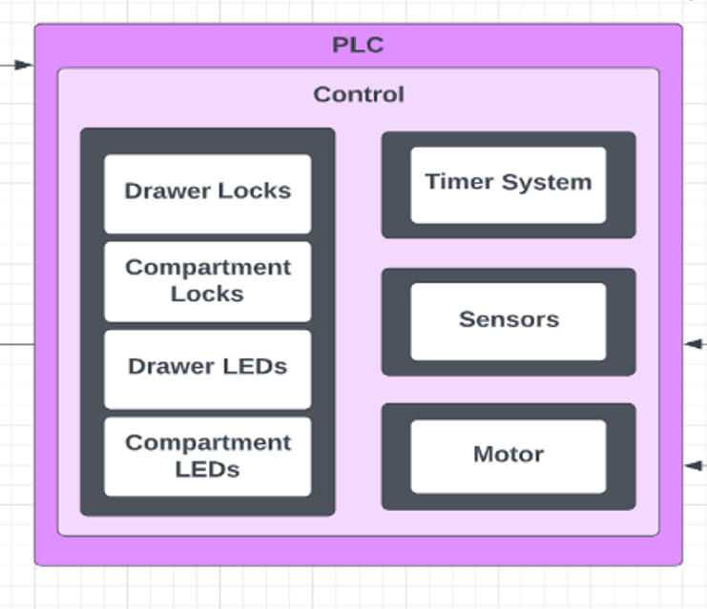
Hardware connections
PLC
HW Control
Locks
Indication
Timer System
Sensors (Addressed later)
Motor

Slide 10
Why a plc & a microcomputer?
PLC’s “run-to-completion” step is Cycle-Driven!
Will always scan code on set interval (ex. every 100ms)
A microcomputer is event-driven: will complete its scan once an event is activated
Could be SIGNIFICANTLY longer
PLCs are used in industry specifically for control technology
Hardware in industry usually controlled by PLCs
If PLCs can do this, why not use it for a database?
PLCs aren’t good with sharing a lot of data
Can’t understand SQL

Slide 11
Plc Control / Hardware
PLC Constraints
ii(1) Must interface with the locks and LEDs
ii(2) Must control the step voltage of the motor(s)
ii(3) Must communicate with the microcomputer
ii(4) Must know the device occupancy of each drawer
ii(5) Must have a timer system
Hardware
PLC receives power from wall outlet
Hardware receives all control from the PLC
Sensors, Locks, Timer System, Indication System, Motor

Slide 12
Hardware subsystems
Stepper Motor
PLC will control driver for motor
Motor steps enough degrees to rotate new device to drawer
Locks
Most likely solenoid (Proposed by MechE team)
Powered by DC voltage
Indication System
Most likely LEDs. Will help guide student to correct drawer and compartment
Controlled by PLC
Timer System
Used to flash LEDs and unlock compartments over a predetermined duration
Controlled by PLC
Will be a system to alternate TON timers

Slide 13
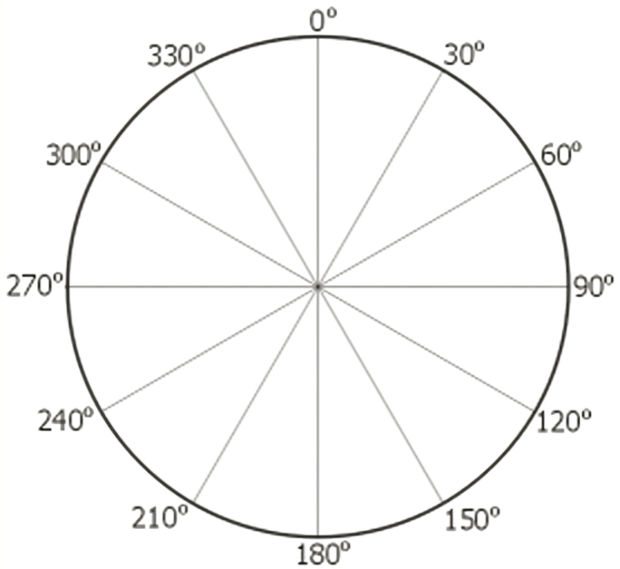
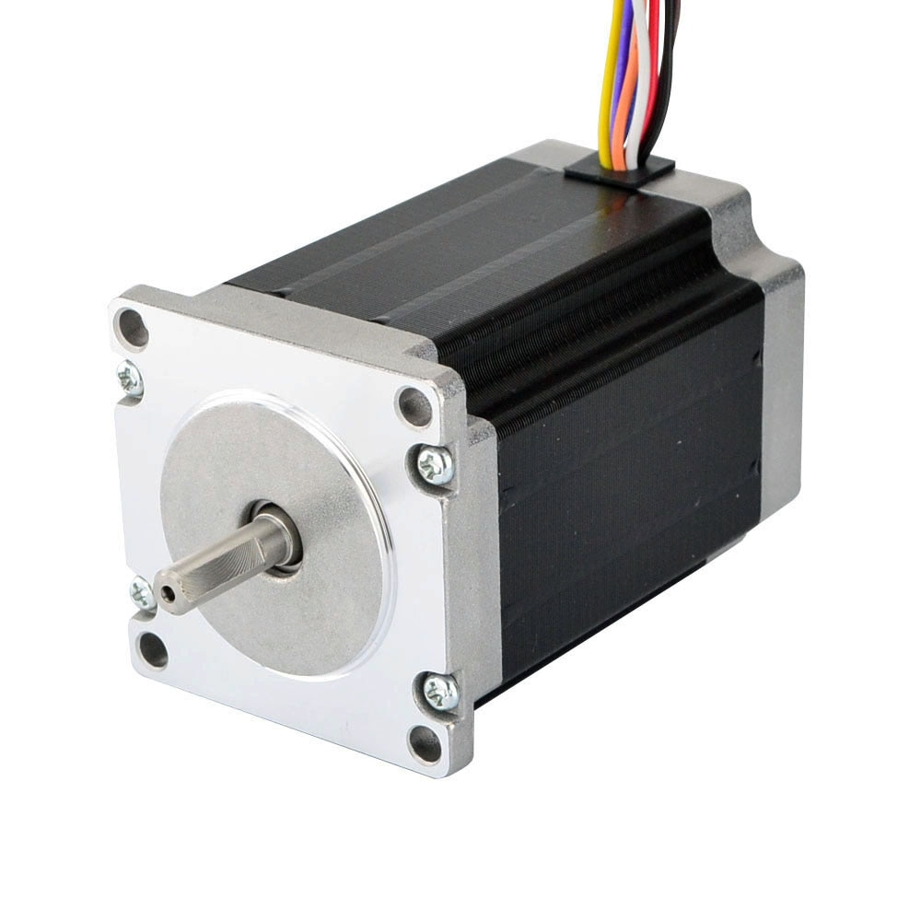
Explanation for Stepper Motor
Stepper Motors are DC motors that divide a full rotation into a set of equal steps.
This will allow us to have better control over the positioning of the machine.

Slide 14
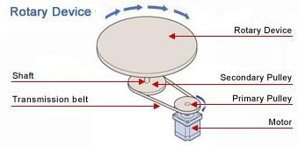
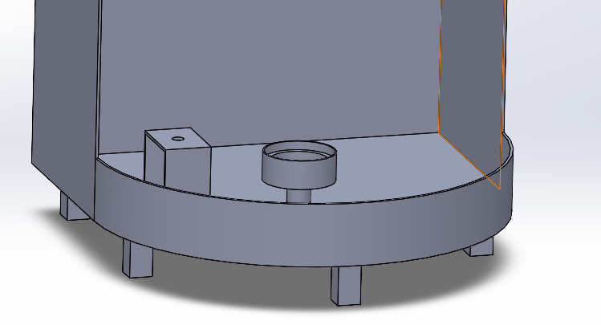
Rotation System

Slide 15
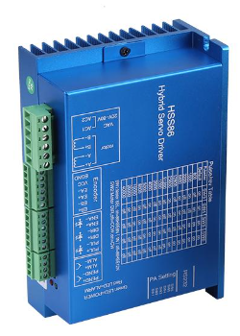
Motor Driver
This motor driver uses a closed-loop system
This improves the accuracy of the motor and makes it so it never loses track of it step.
This driver also includes over-current, over-voltage and position ultra difference protection

Slide 16
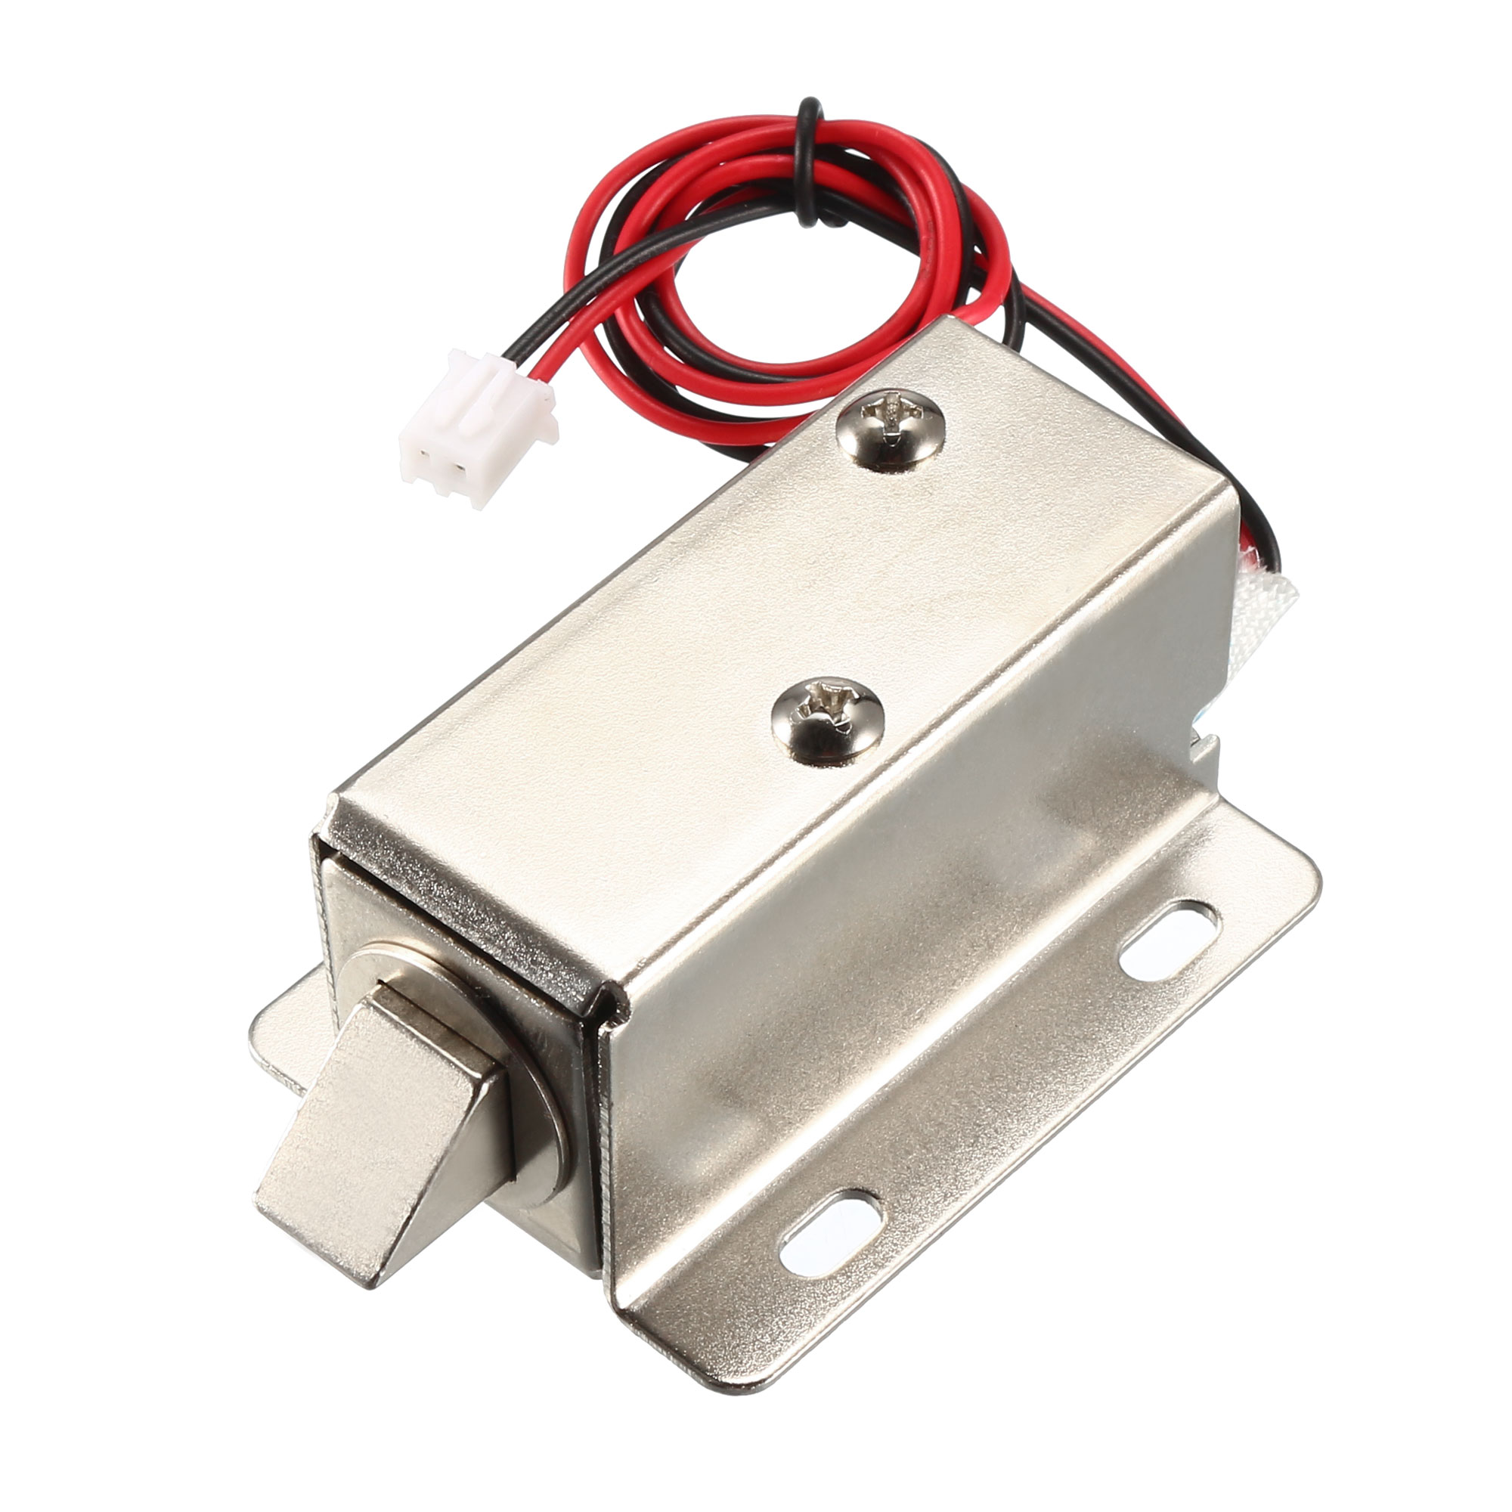
Locks
Main security for the physical system.
There are locks for each of the compartments and another for the storage/maintenance space.
Needs to stay lock when power is lost.

Slide 17
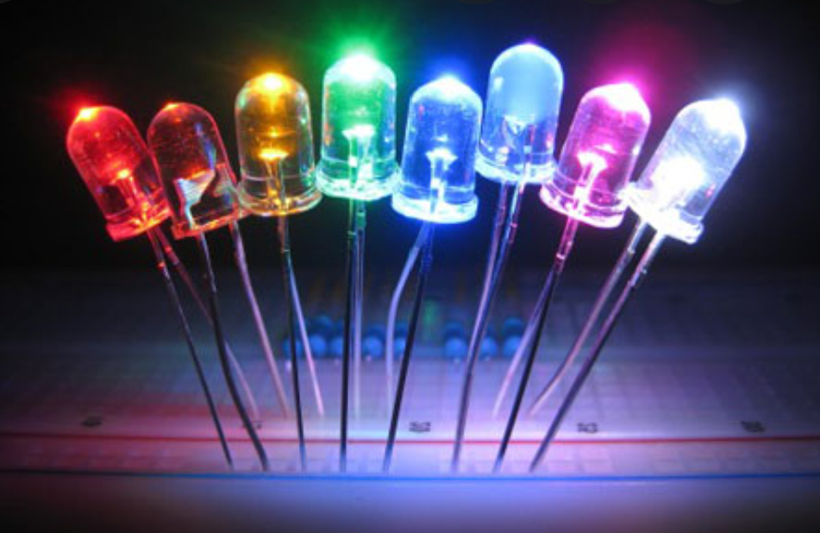
LEDs and Indicators
There are 3 compartments, one for each level.
The LED will show the user the location of their device.

Slide 18

Barcode Scanner
Used to scan in the ID/barcode attached to the device’s box.
Makes it easy to keep track of items have been registered to the database.
Will be used by the operator during the “LOAD” mode.

Slide 19

LOAD Mode (Button Included)
Mode for loading and registering items to the machine.
The display will inform the user of the compartment, indicated by an LED, that needs a refill. (The only one unlocked)
The operator will scan the ID of the device and load it into position.
After a confirmation of the board being loaded, the machine will automatically rotate to the next empty slot.

Slide 20
Power
Power Supply
AC/DC Converter
Overcurrent Protection
GFCI-protected outlet
NEC 422.51
Circuit Breaker
Fuses
Op-Amp Circuits
Constraints:
iv(1) As per the standard NEC 422.51, the power system must have a ground fault current interrupter (GFCI) to protect against the current surge.
iv(2) The power system must have an AC/DC converter to send power to the voltage-sensitive components.
iv(3) The power system must have an emergency stop control.

Slide 21

Systems that require Power
Microcomputer
PLC
Motor
LEDs
Locks
Barcode Scanner
Card Reader

Slide 22
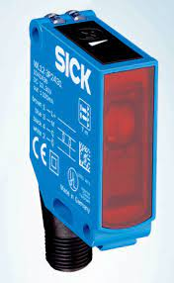
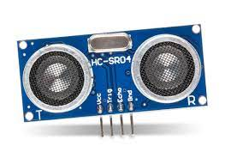
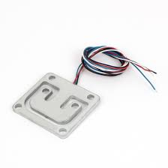
Sensors
To determine occupancy of each compartment
Hundreds of options to consider
Ideals
Small Size
One bit output
Cheap
Easy Calibration
Constraints: iii(4) The PLC must know the device occupancy of each drawer.

